Slide 1

Build Native Designed Apps with Xamarin and MvvmCross

Slide 2

Introduction
Maurits van Beusekom
@mvanbeusekom
maurits@vnbskm.nl
github.com/mvanbeusekom

Slide 3

Progress is teamwork

Slide 4

Goals of this session
What is Xamarin
Benefits of Xamarin Native
Quick intro to MVVM
Explain how MvvmCross fits in
Demo: Create a Xamarin Native App with MvvmCross

Slide 5
Xamarin’s Mission
Make it fast, easy, and fun to create great mobile apps.

Slide 6
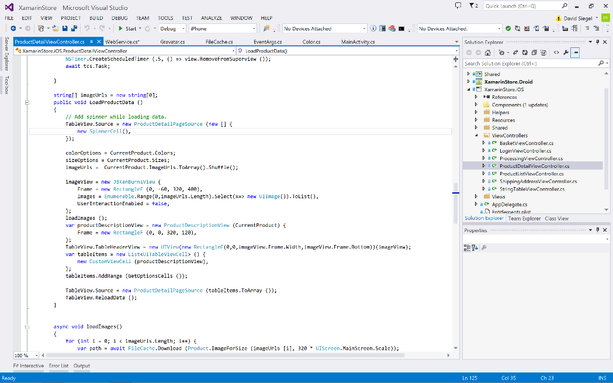
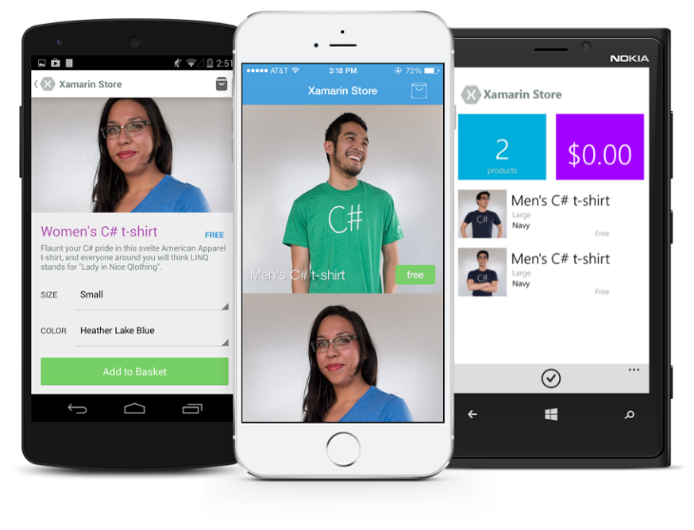
Anything you can do in Objective-C, Swift, or Java can be done in C# and Visual Studio with Xamarin.

Slide 7



Xamarin Native & Xamarin.Forms
iOS C# UI
Android C# UI
Windows C# UI
Shared UI Code
Shared C# Backend
Shared C# Backend
Traditional Xamarin Approach
With Xamarin.Forms: More code-sharing, all native

Slide 8
Why the Xamarin Native
Depends on the team and type of project.
Full control of UI
Direct access to all platform specific APIs
Quick incorporation of new native concepts
Performance
Leverage platform specific knowledge

Slide 9
What is MVVM
View
View
Model
Model
Databinding
Presentation layer
Business layer
The Model-View-ViewModel pattern is popular with frameworks that support data-binding, such as Xamarin.Forms.

Slide 10
MVVM vs. MVC
MVVM is a variant of the Presentation Model (a.k.a. MVP) design pattern and both derive from the MVC pattern.
Model - View - Controller
View
Login.xib
Controller
LoginController
Model
User
Benefits:
Testability
Modularity & Flexibility
Maintenance
Model - View - ViewModel
View
Login.xib
LoginController
ViewModel
LoginViewModel
Model
User
Databinding

Slide 11
MvvmCross

Slide 12



Cross platform
Most advanced Mvvm library for Xamarin and .NET cross platform
Support for all major platforms

Slide 13



Fast release cycle
Large and engaged community
Clean & easy conventions

Slide 14
MvvmCross Binding
MvvmCross comes with advanced build-in binding for all native platform specific controls.
By default works for custom controls which
Use public properties (One-Way binding)
Signal changes through C# events (Two-Way binding)
Features:
One-Way, Two-Way or One-Time binding modes
Manipulate values with converters or combiners
Fallback values
Easily create and register custom bindings

Slide 15



MvvmCross Presenters
Enables the best Native UI
Easy to implement custom presenters
Most code reuse
Using the presenters saves you budget because you only need to code navigation once
Build beautiful Native Apps using Xamarin and MvvmCross!
Enables you to customize the behavior of your app without making your app multiple times

Slide 16
Android View Presenter
The default Android View Presenter (MvxAndroidViewPresenter or MvxAppCompatViewPresenter) supports the following strategies*:
Activities
Fragments
Dialog fragments
TabLayout / ViewPager
* Strategies are configured through attributes
Example:
[MvxFragmentPresentation(
typeof(RootViewModel),
Resource.Id.content_frame)]
public class ChildView :
MvxFragment<ChildViewModel>
{
public override View OnCreateView(
LayoutInflater inflater,
ViewGroup container,
Bundle savedInstanceState)
{
…
}
}

Slide 17
iOS View Presenter
The default iOS View Presenter (MvxIosViewPresenter) supports the following strategies*:
Stack navigation
Tabs
Split view
Modal
Modal navigation
Nested modals
* Strategies are configured through attributes
Example:
[MvxRootPresentation(
WrapInNavigationController = true)]
public partial class RootView :
MvxViewController<RootViewModel>
{
…
}
[MvxChildPresentation]
public partial class ChildView :
MvxViewController<ChildViewModel>
{
…
}

Slide 18
MvvmCross Navigation
Navigation in MvvmCross is done on ViewModel level.
Maximizes code reuse
No platform specific knowledge needed
Async support
Strongly typed parameters

Slide 19
Navigation example
public class MainViewModel : MvxViewModel
{
private readonly IMvxNavigationService _navService;
public MainViewModel(IMvxNavigationService navService)
{
_navService = navService
?? throw new ArgumentNullException(nameof(navService));
NavigateCommand = new MvxAsyncCommand(
async () => await _navService.Navigate<ChildViewModel>();
);
}
public IMvxAsyncCommand NavigateCommand { get; }
}

Slide 20

MvvmCross Plugins
Easily extend MvvmCross with plugins. Some existing plugins are:
Color
Email
Localization
Messenger
Network
Phonecall
PictureChooser
Visibility
And many more…
Plugins available through NuGet or:
https://github.com/MvvmCross/MvvmCross

Slide 21

demo time!
Code available at: https://github.com/Xablu/TechDays2017

Slide 22

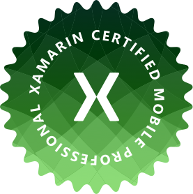

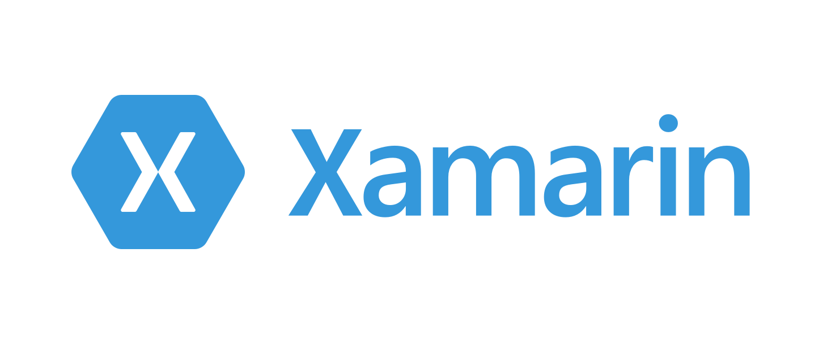
Xablu training program
With our partner Global Knowledge we provide Xamarin training:
Introduction to Xamarin
How to create an app with Xamarin.iOS, Xamarin.Android and Xamarin.Forms
Connect your app with REST API’s
Publish your app to the store(s)
Become Xamarin Certified Professional!

Slide 23





Get Involved!
Get help on Slack xamarinchat.herokuapp.com #MvvmCross channel
Follow us on Twitter @MvvmCross @mvanbeusekom
Support MvvmCross! Opencollective.com/mvvmcross
Join the LinkedIn group linkedin.com/groups/8456977 MvvmCross & Xamarin group
Contribute on Github Github.com/MvvmCross/MvvmCross

Slide 24
Thank you! Questions?

